Slide 1

EEE 1201
Introduction to Electrical Engineering
S. M. Naimur Rahman Sayam
Lecturer Department of CSE

Slide 2
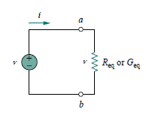
BASIC CONCEPTS
Electric circuit
An electric circuit is an inter connection of electrical elements
Fig: Electric circuit

Slide 3
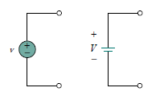

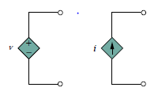
CIRCUIT ELEMENTS
Passive elements - Resistors, Capacitors, Inductors
Active elements – Voltage source, Current source
There are two kinds of sources
Independent
2. Dependent

Slide 4


Electric current is the time rate of change of charge, measured in amperes (A)
To move the electron in a conductor in a particular direction requires some work or energy transfer. This work is performed by an external electromotive force (emf). This emf is also known as voltage or potential difference.
Voltage (or potential difference) is the energy required to move a unit charge through an element, measured in volts (V).

Slide 5

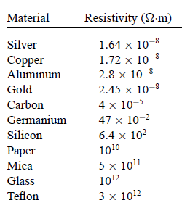
The resistance R of an element denotes its ability to resist the
flow of electric current; it is measured in ohms.
ρ is known as the resistivity of the material in ohm-meters

Slide 6

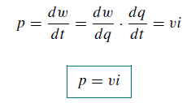
Power is the time rate of expending or absorbing energy, measured in watts (W)

Slide 7


BASIC LAWS
Ohm’s law
At constant temperature, the potential difference conductor is directly proportional to the flow of through the conductor.
across a electrons

Slide 8
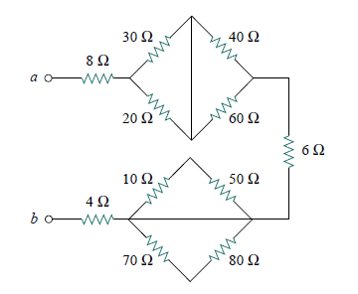
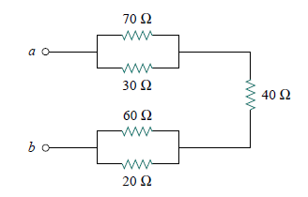
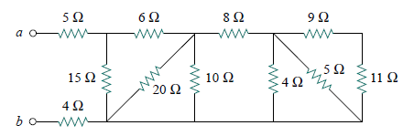
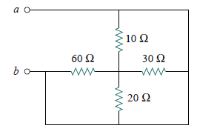
Series Parallel Circuit
Obtain the equivalent resistance at the
terminals a-b for each of the circuits:

Slide 9
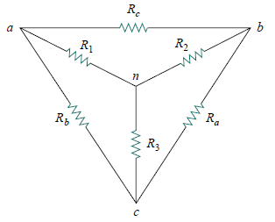

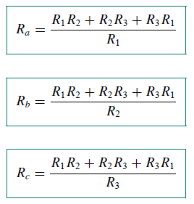


Delta to Wye Conversion

Slide 10
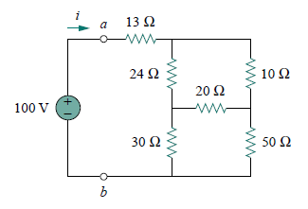
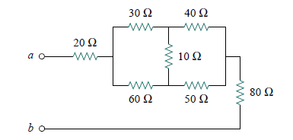
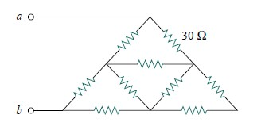
Obtain the equivalent resistance at the terminals a-b for each of the circuits:
All resistors have a value of 30

Slide 11



Kirchhoff’s laws

Slide 12
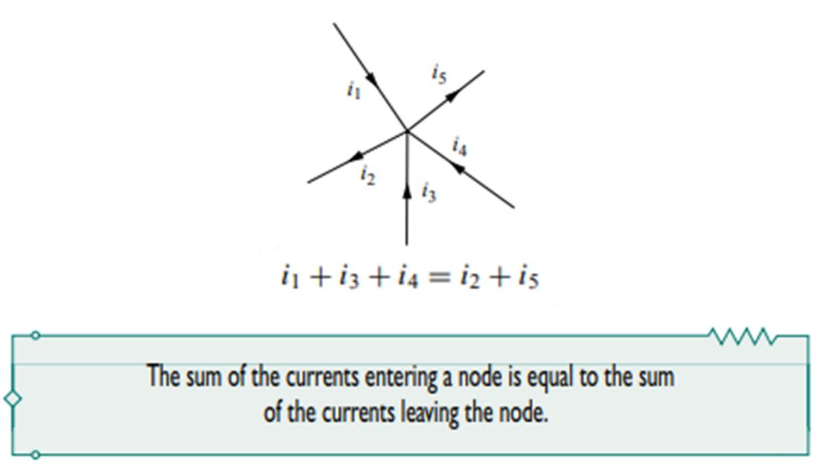
Kirchhoff’s current law (KCL) states that the algebraic sum of currents entering a node (or a closed boundary) is zero.

Slide 13
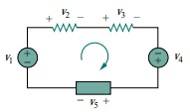

Kirchhoff’s voltage law (KVL) states that the algebraic sum of all voltages
around a closed path(or loop) is zero.
v2 + v3 + v5 = v1 + v4

Slide 14
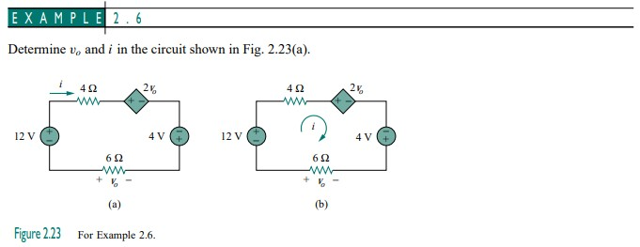
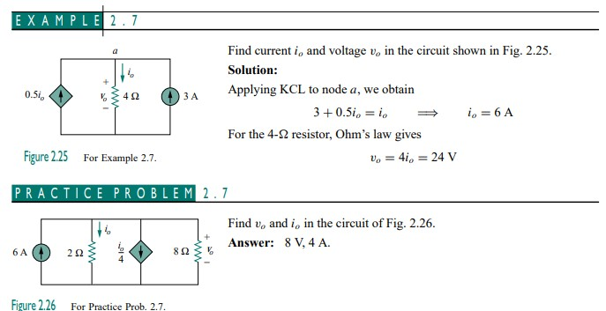

Slide 15
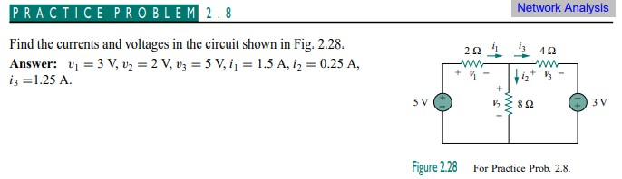
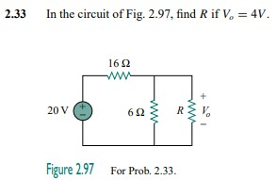
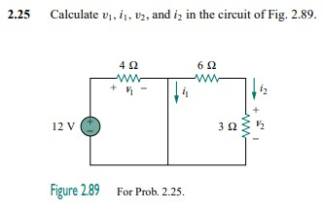

Slide 16
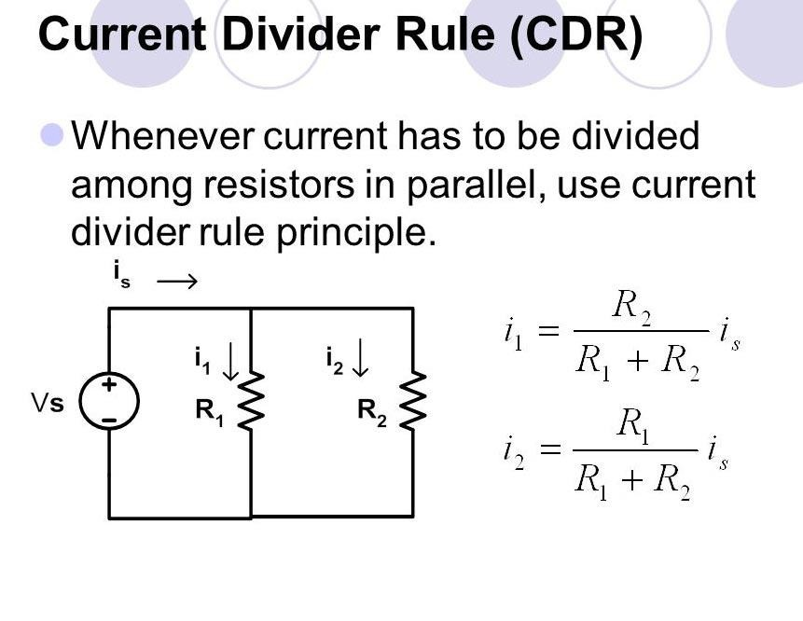

Slide 17
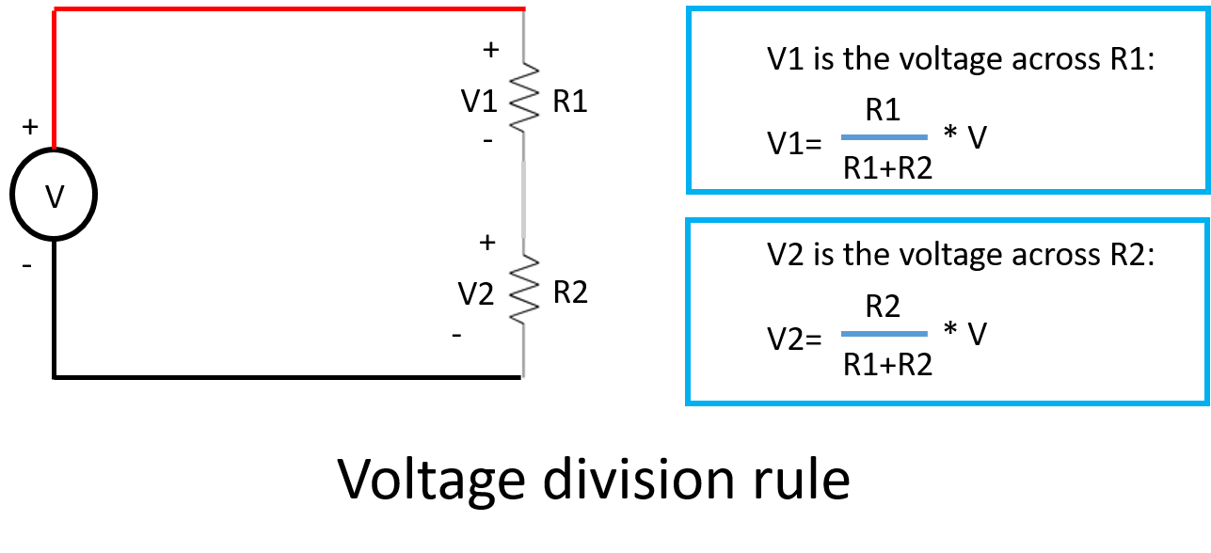

Slide 18

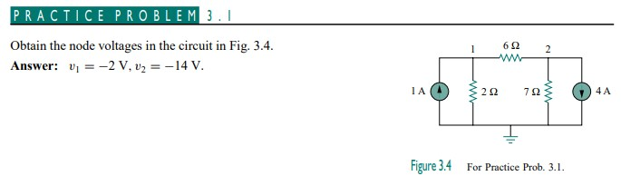
Methods of analysis
Nodal analysis
Current flows from a higher potential to a lower potential in a resistor

Slide 19
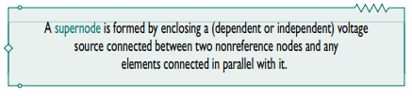
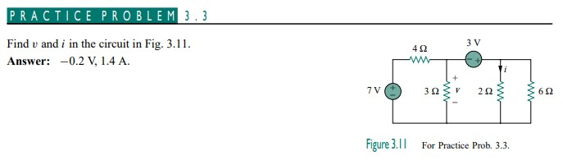

Slide 20
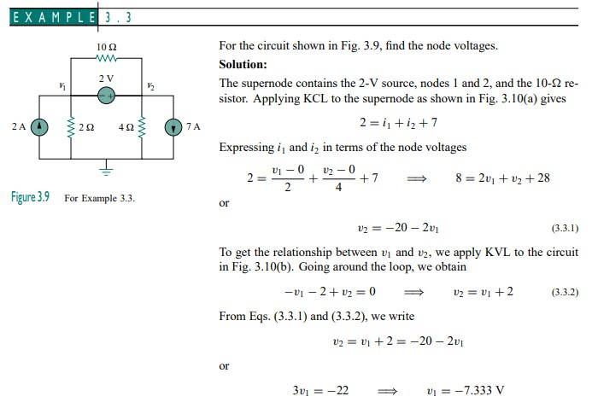
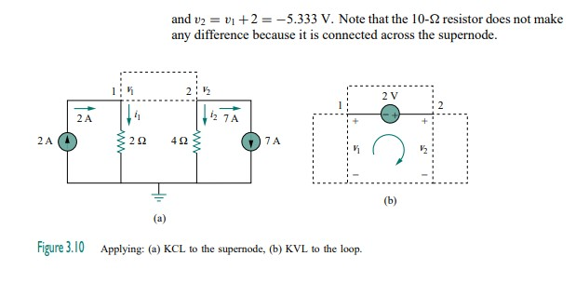

Slide 21

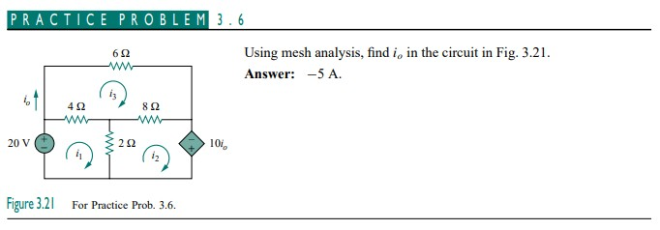
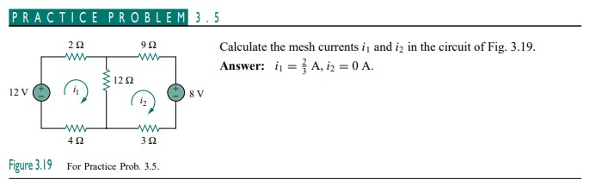
Mesh analysis

Slide 22

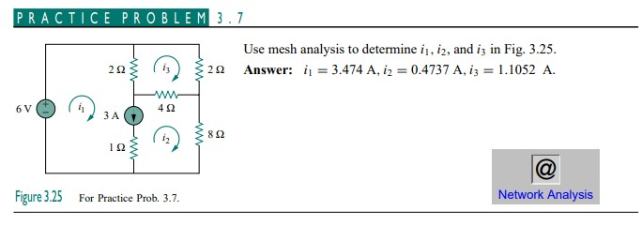

Slide 23
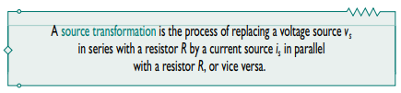
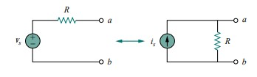
Circuits Theorem
1. Source transformation

Slide 24
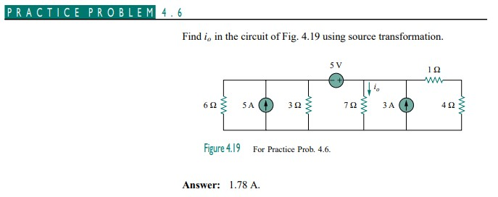
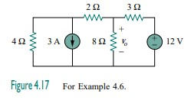

Slide 25
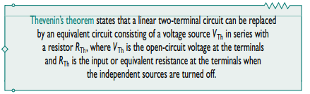

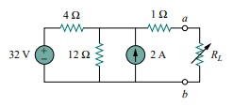
2. Thevenin’s theorem

Slide 26
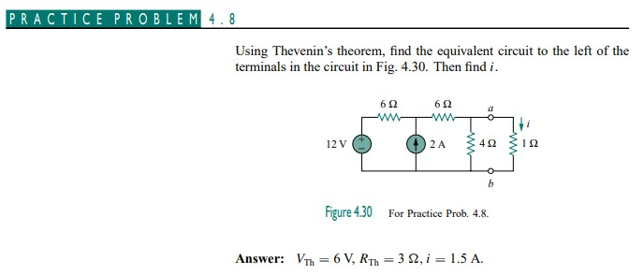
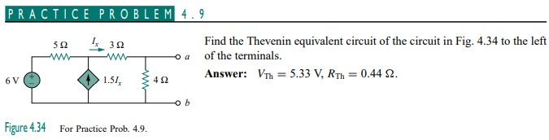
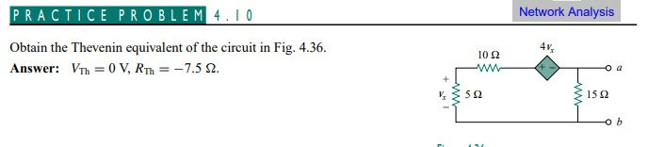

Slide 27
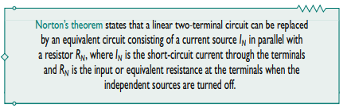
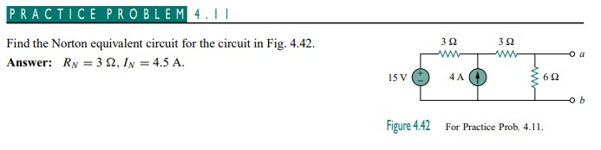
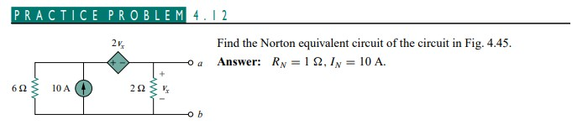
3. Norton’s theorem

Slide 28

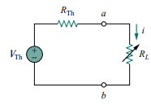


4. Maximum Power Transfer Theorem
The power delivered to the load is,
EQUATION 1
To prove the maximum power transfer theorem, we differentiate ‘p’ with respect to RL and set the result equal to zero. We obtain,

Slide 29
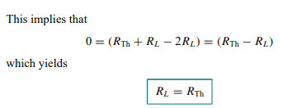

showing that the maximum power transfer takes place when the load resistance RL equals the Thevenin resistance RTh.
The maximum power transferred is obtained,
Putting RL=RTH in equation 1

Slide 30
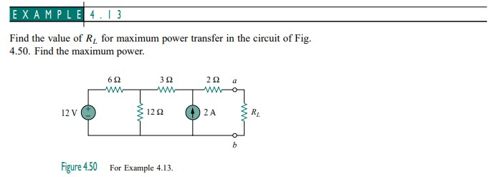
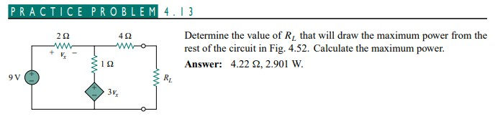

Slide 31
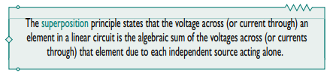
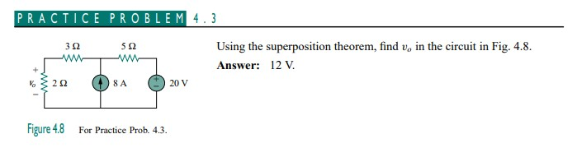

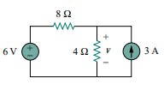
5. Superposition Theorem

Slide 32

AC
Circuits

Slide 33

Complex Numbers and Phasors
We can convert COMPLEX numbers from one form to the other form.

Slide 34


Slide 35



SINUSOIDS
T is called the period of the sinusoid
The reciprocal of the period of the sinusoid is the number of cycles per second, known as the cyclic frequency, f of the sinusoid.

Slide 36


Trigonometric identities

Slide 37



Slide 38



leading and lagging
To find leading and lagging, firstly we need to convert a wave into + Sine wave
Solution:

Slide 39




Phasors
Firstly we need to convert a wave into + cosine wave

Slide 40


Slide 41



PHASOR RELATIONSHIPS FOR CIRCUIT ELEMENTS

Slide 42


The Admitance, Y of a circuit is the reciprocal of impedance measured in Simens (S).

Slide 43




IMPEDANC E COMBINATIONS

Slide 44



Delta-Y Conversion

Slide 45






Slide 46



Slide 47



Slide 48



Slide 49




NODAL AND MESH ANALYSIS

Slide 50



Slide 51




Slide 52

SUPERPOSITION THEOREM
The theorem becomes important, if the circuit has sources operating at different frequencies.

Slide 53



Slide 54


THEVENIN AND NORTON EQUIVALENT CIRCUITS

Slide 55


Slide 56




AC POWER ANALYSIS

Slide 57


Slide 58



EFFECTIVE OR RMS VALUE

Slide 59





(which is measured in watts, W)
Average power OR Real power:
Apparent power:
(It is measured in volt-amperes or, VA)
Reactive power:
(The unit of Q is the volt-ampere reactive, VAR)
Complex Power:
(It is measured in volt-amperes or, VA)

Slide 60


Power Factor
The power factor is dimensionless, since it is the ratio of the real
power to the apparent power.
The power factor indicates, how much real power we consume from total power supply.

Slide 61


Slide 62


Slide 63


Slide 64

Thank you

